Slide 1
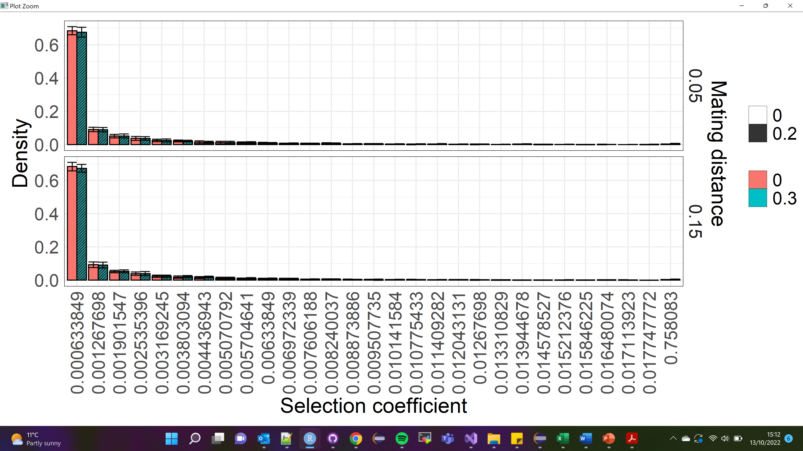

Slide 2
Add neutral genetics to get homozygosity and structure across space
Screenshots of structure
How do we calculate Ne to scale x
What are we looking for here
Fixed and segregation DFE

